Slide 1
Amazon Connect
ISV Partner Onboarding
April 2018

Slide 2
Getting Started
Amazon Connect Integration Guide on GitHub
Explanation of the technical validation process, what to expect, and deliverables you will need to provide
Guidance on leveraging Amazon Connect’s integration points
Detailed instructions on using CloudFormation and testing your integration
Training Materials

Slide 3
Where does my integration get published?
AWS Marketplace
Amazon Connect Streams API
Amazon Kinesis Application
AWS hosted SaaS or AMI
AWS Solutions Space
Amazon Connect
Amazon ML Application Services
Comprehend, Lex, Polly, Transcribe & Translate
Amazon ML Platform Services
SageMaker & ML
AWS Quick Start
Kinesis Streams/Firehose
AWS Lambda
Amazon API Gateway
Amazon DynamoDB
Other AWS services supported through CloudFormation
Notes:
Depending on the specific use case, the scope of an integration will vary as it may be comprised of a variety of services.
Most AWS services are exposed to CloudFormation and can therefore be provisioned through programmatic means.
Wherever possible, we recommend using this method as it provides rapid, stable, secure, consistent and cost-effective deployments.
This diagram illustrates the three groups within AWS which may host the respective components of a partner integration.
Examples of the various services that would be appropriate for each group are listed beneath these.

Slide 4
AWS Marketplace Benefits
Streamlined Software Delivery
Offer software as a managed Amazon Machine Image (AMI) and take advantage of our 1-Click purchasing feature. Customers can launch pre-configured software in minutes. if you offer a Software as a Service (SaaS) product, customers can subscribe to it in Marketplace, register and use your software on your site, and pay for it on their AWS bill.
Discover New Customers
Capitalize on the growth of cloud computing. By launching directly from AWS Marketplace, customers can run software instantly, decreasing the length of your sales cycle. Sellers can also offer free trials with no additional engineering effort.
Simplified Billing & Payments
Customers pay for AWS Marketplace software as part of the regular AWS billing cycle. AWS manages the complexity of metering, billing, payment collection and financial reporting so sellers can focus on building and selling core products.
Provide Seamless Product Support
AWS Marketplace Product Support Connection makes it easy to support your customers on AWS Marketplace. Using Product Support Connection, customers can choose to share contact data with vendors through the AWS Marketplace web site, simplifying and streamlining requests for product support.

Slide 5
Selling on AWS Marketplace
How to Sell Your Software on AWS Marketplace
Register with AWS Marketplace
Complete the registration prerequisites specified in the AWS Marketplace Seller Guide and submit your Seller Application. If you intend to list applications in AWS Marketplace for Desktop Apps (AMDA) for use with Amazon WorkSpaces, please review the AMDA Vendor Guide.
Build Your Product
Review the AWS Marketplace Seller Guide and visit the Self-Service Listings portal to create your first listing. If you have any questions, feel free to contact our team. If you have a SaaS product, read the SaaS Subscriptions Integration Guide for more information.
Start Selling
Customers can now immediately find, deploy, and buy your software products on AWS Marketplace. You can log in to the AWS Marketplace Management Portal to access channel management tools, track marketing performance, and implement best practices for your listing.

Slide 6
Amazon Connect Streams API
When do I use Amazon Connect Streams API?
The Amazon Connect Streams API (Streams) gives you the power to integrate your existing web applications with Amazon Connect. Streams lets you embed the Contact Control Panel (CCP) UI components into your page, and/or handle agent and contact state events directly giving you the power to control agent and contact state through an object oriented event driven interface. You can use the built in interface or build your own.
Learn More
Notes:
Integrations that depend on having agent call control embedded within their web browser should consider leveraging the Amazon Connect Streams API.

Slide 7


Amazon Kinesis Application
When do I use an Amazon Kinesis Application?
An Amazon Kinesis Application is a data consumer that reads and processes data from an Amazon Kinesis data stream. You can build your applications using either Amazon Kinesis Data Analytics, Amazon Kinesis API or Amazon Kinesis Client Library (KCL). Amazon Connect allows you to stream Contact Trace Records as well as Agent Events to Kinesis Streams. Building an Amazon Kinesis Application will allow you to ingest the data produced by Amazon Connect.
Amazon Kinesis Streams
Amazon Connect Data Streaming
Contact Trace Records
Agent Events
Amazon Kinesis Application
Amazon Kinesis Analytics
Amazon Kinesis API
Amazon Kinesis Client Library
Notes:
Amazon Connect utilizes Amazon Kinesis to stream various data.
Once an instance of Amazon Connect has been provisioned, Kinesis Streams and/or Kinesis Firehose must be provisioned if this feature will be utilized.
In order to ingest the data produced by Kinesis, a few options exist:
AWS Lambda function (invoked when data is written to the stream and can copy that data to an external store)
Amazon Kinesis Application (hosted within the partner’s own application)
Amazon Kinesis Analytics
Amazon Kinesis API
Amazon Kinesis Client Library

Slide 8


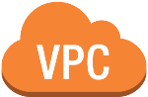


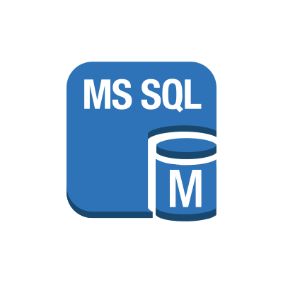

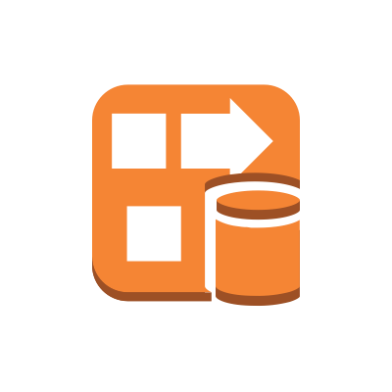


Scenario 1
AWS Region
LEGEND
Call Recordings &
Scheduled Reports
Lambda Functions
Quick Start
Solution Space
Marketplace
AMI
DB
Amazon Connect
CTR
Kinesis Firehose
delivery stream
Kinesis
stream
Amazon ES
Security group
Virtual private cloud
Notes:
This diagram represents an example Amazon Connect integration where the partner has selected to provide an Amazon Machine Image.
While the AMI itself is listed in the AWS Marketplace, provisioning is made possible through a CloudFormation template which will include the AMI as well as other dependent AWS services that comprise the integration.
This CloudFormation template will be hosted in the Amazon Connect Integrations Portal hosted by AWS Quick Starts and will contain a link pointing to the Marketplace listing.
A Solution Space listing is created which includes a limited-scope consulting offering bundled with the provisioning of the CloudFormation template and associated Marketplace listing.

Slide 9




Scenario 2
AWS Region
Call Recordings &
Scheduled Reports
LEGEND
ECS
DynamoDB
Quick Start
Lambda Functions
Solution Space
Amazon Connect
Kinesis App
S3
Marketplace
Security group
Kinesis
stream
Virtual private cloud
AWS Region
Notes:
This diagram represents an example Amazon Connect integration where the partner has selected to provide a SaaS model.
In this scenario, the partner may utilize their own method for provisioning of the multi-tenancy, the remaining services that comprise the integration which are expected to run in the customer’s own AWS account are provisioned through a CloudFormation template.
This CloudFormation template will be hosted in the Amazon Connect Integrations Portal hosted by AWS Quick Starts and will contain a link pointing to the Marketplace listing.
A Solution Space listing is created which includes a limited-scope consulting offering bundled with the provisioning of the CloudFormation template and associated Marketplace listing.

Slide 10
Scenario 3
AWS Region
Call Recordings &
Scheduled Reports
LEGEND
Partner SaaS or On-Premises
Quick Start
Lambda Functions
Solution Space
Amazon Connect
Kinesis
stream
Notes:
This diagram represents an example Amazon Connect integration where the partner has selected to provide a On-Premises or SaaS model which may be hosted either in AWS or any other Cloud.
In this scenario, the partner may utilize their own method for provisioning of the multi-tenancy, the remaining services that comprise the integration which are expected to run in the customer’s own AWS account are provisioned through a CloudFormation template.
This CloudFormation template will be hosted in the Amazon Connect Integrations Portal hosted by AWS Quick Starts and will contain a link pointing to the partners customer registration portal.
A Solution Space listing is created which includes a limited-scope consulting offering bundled with the provisioning of the CloudFormation template.

Slide 11








Validation and Publishing Process
Become a Standard Tier
APN Partner
Review Amazon Connect Integration Guide
Build your integration
Submit code for review
Code & Documentation Review
Draft documentation
Launch!
Revisions
Notes:
This diagram depicts the process for a partner who is interested in building an integration to Amazon Connect.
It begins with registering as an APN partner and achieving Standard Tier.
Review the Amazon Connect Integration Guide published on GitHub and familiarize yourself with the various AWS services you may use for your integration.
Begin building your integration and consult with the Partner Solution Architecture team for feedback and guidance.
Draft documentation describing the integration including a diagram of the various components and how these work together. Also review the connect-integrations-example repository published on GitHub and use that as a reference.
Once you have a CloudFormation template ready to be validated, submit a request to the Partner Solutions Architecture team requesting that an AWS GitHub repository for your integration be created for you and commit your code for review.
Both the documentation and the code submitted will be reviewed. This process is rigorous and will likely consist of a few iterations.
Once all items have been reviewed, all changes requested made, validated and tested, you will receive your launch date.

